Slide 1
DemoBlaze E-Commerce Website Testing Project
Manual Testing Project Report
By: Bashira

Slide 2
Introduction
DemoBlaze is an e-commerce web application with modules such as:
- Login & Registration
- Product Browsing/Search
- Add to Cart
- Checkout
Objective: Validate core functionalities through manual testing.

Slide 3
Test Plan Summary
- Scope: Login, Browse, Cart, Checkout modules
- Tools: Excel, JIRA (optional)
- Approach: Manual test cases execution
- Deliverables: Test Plan, Test Cases, Defect Report, Execution Summary

Slide 4
Test Scenarios
Login Module:
- Valid Login
- Invalid Login
- Empty Credentials
- Logout
Browse/Search Module:
- Browse products by category
- Search product
Cart Module:
- Add product to cart
- Remove product from cart
- Cart validation
Checkout Module:
- Valid checkout
- Empty checkout
- Invalid details

Slide 5
Test Cases
Sample:
TC_Login_01: Verify valid login
Steps: Open DemoBlaze → Click Login → Enter valid credentials → Submit
Expected: User successfully logged in.
TC_Cart_01: Add product to cart
Expected: Product appears in cart with correct price.

Slide 6
Defect Report
Example Defects:
1. Login accepts empty credentials → Bug ID: DEF_01
2. Cart not updating total price correctly → Bug ID: DEF_02

Slide 7
Execution Summary
Total Test Cases: 20
Passed: 16
Failed: 4
Pass Percentage: 80%
Overall Result: Application stable with few critical defects.

Slide 8
Conclusion
✔ Core modules tested successfully
✔ Critical bugs reported
✔ Provides confidence in application stability
Next Steps:
- Fix reported defects
- Retest failed scenarios
- Regression testing

Slide 9
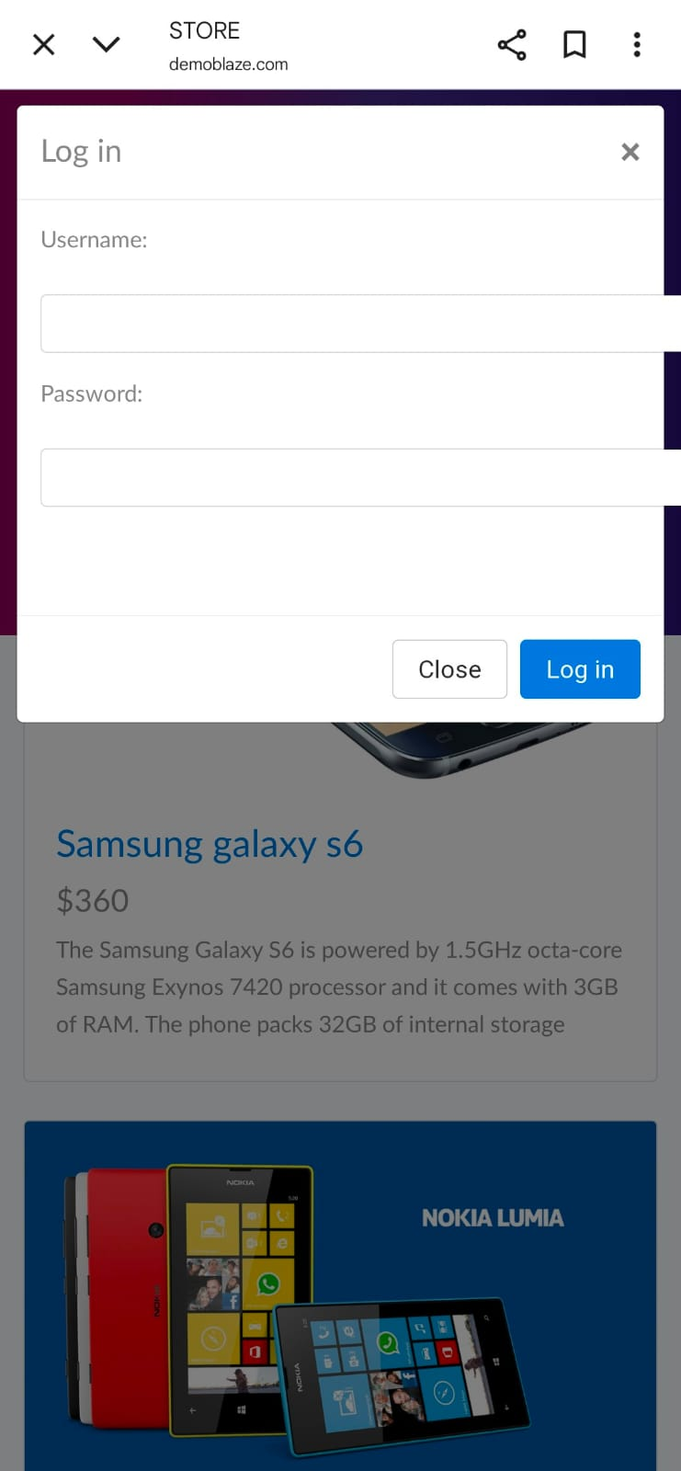
Login Page Screenshot

Slide 10
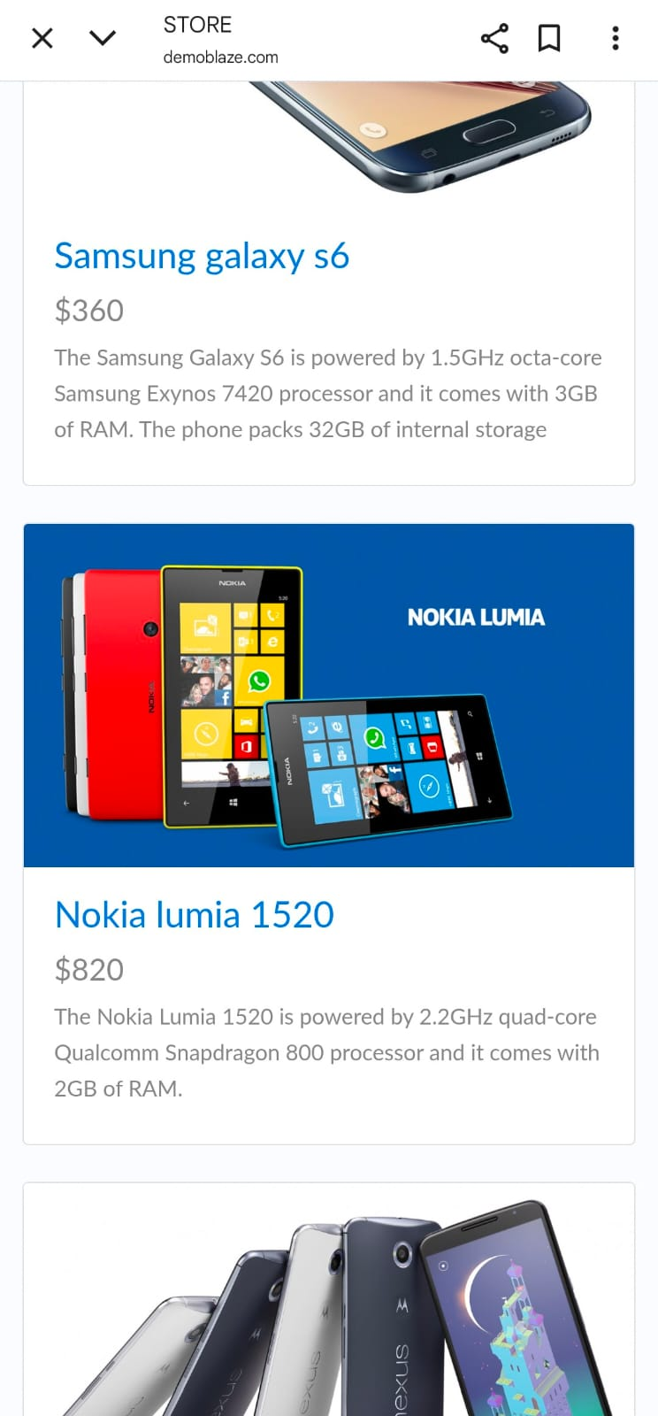
Product Browsing Screenshot

Slide 11
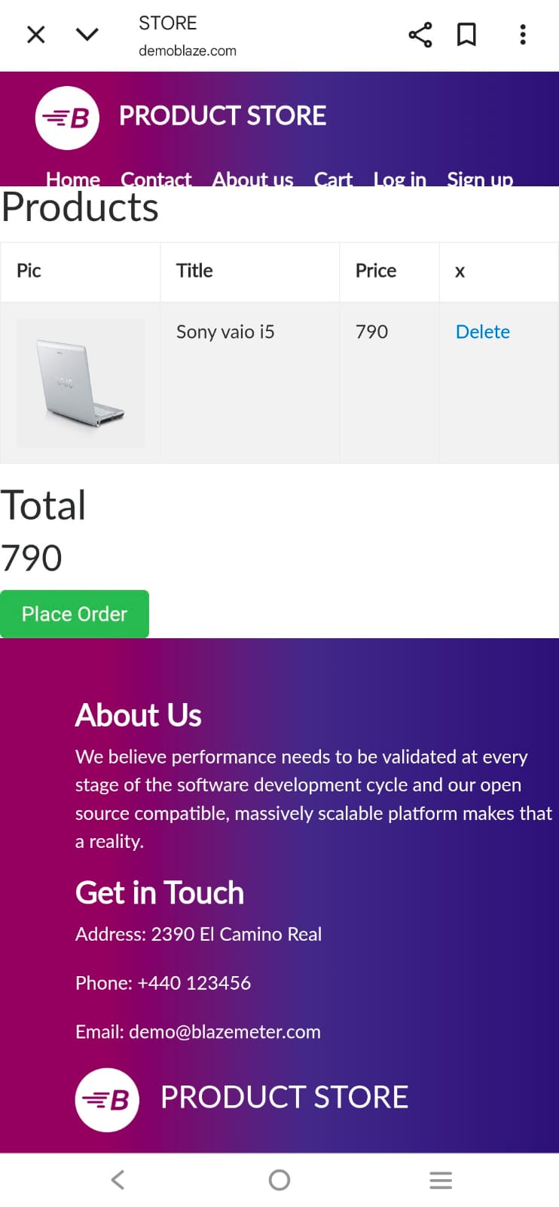
Cart Page Screenshot

